Slide 1
What Causes Wind?

Slide 2
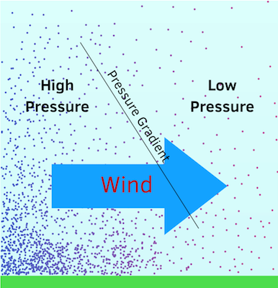
What Causes Wind?
Winds in the atmosphere occur because of a difference in pressure between two points.
This pressure difference is known as a “pressure gradient”.
Similar concept to water flowing downhill.

Slide 3
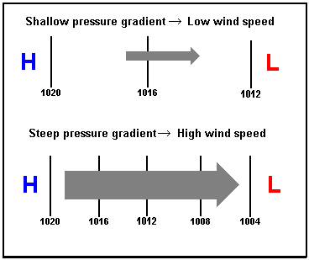
Pressure Gradient Force
The force associated with the pressure gradient is known as the pressure gradient force, and it is directed from high to low pressure.
The magnitude of the force is based on the change in pressure over distance.
The steeper the hill, the faster the fluid flows!

Slide 4
Forces Acting on the Wind
While the pressure gradient force causes winds to occur, other forces act on the wind to change its intensity and/or direction:
Coriolis force
Surface friction
These three forces are what causes winds to change speed and direction across the Earth.

Slide 5
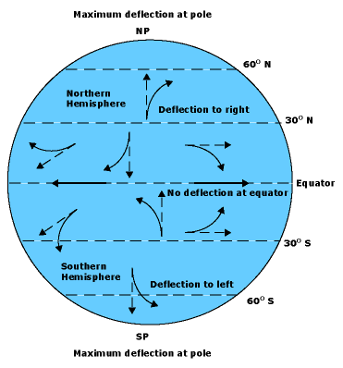
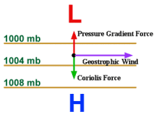
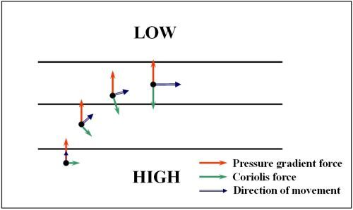
Coriolis Force
The Coriolis Force occurs due to the rotation of the Earth, which makes winds appear to “deflect”.
Winds in the Northern (Southern) Hemisphere deflect to the right (left) of the direction of motion, with the strongest deflection at the Poles and zero at the Equator.
Winds resulting from a balance between the Pressure Gradient force and the Coriolis force are referred to as “Geostrophic” winds.

Slide 6
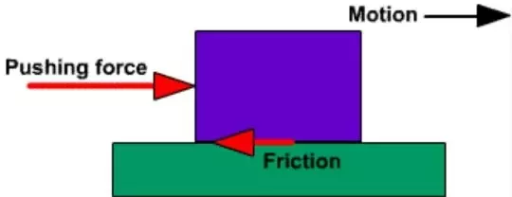
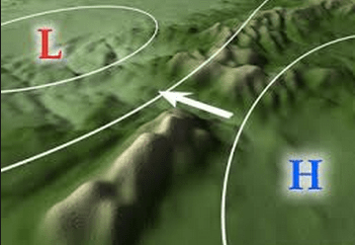
Surface Friction
Friction at the surface can slow winds down through frictional dissipation.
In the case of large surface features such as mountain ranges, the wind can be deflected.

